Slide 1
Setting up R and Python for web scraping
Dr. Anil Shrestha
Undersecretary (Account)
Financial Administration Section
National Statistics Office

Slide 2
Setting up Python

Slide 3
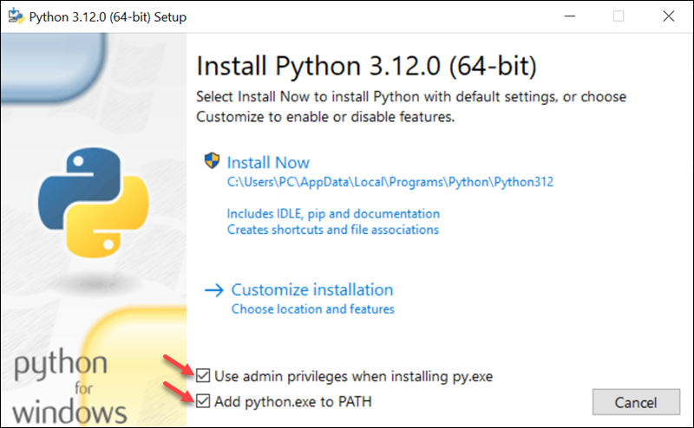

Slide 4
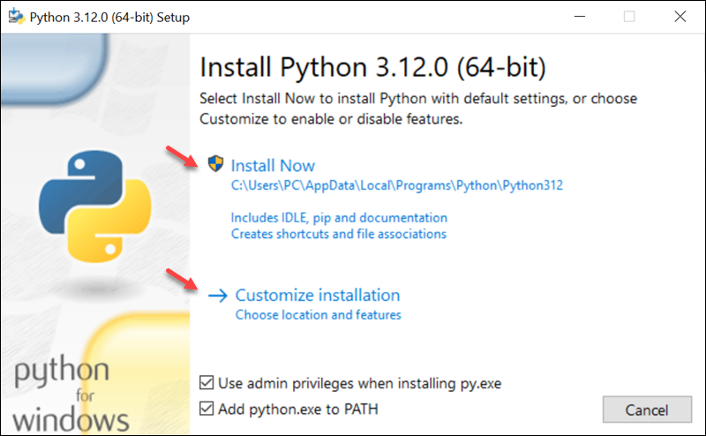

Slide 5
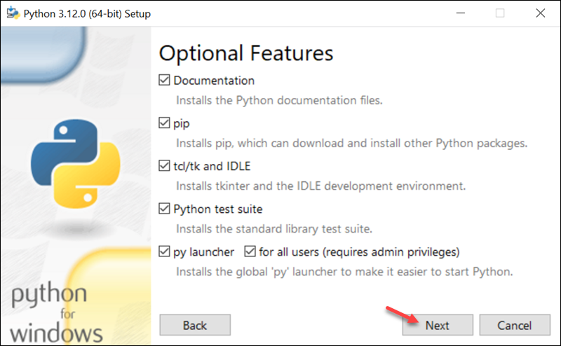

Slide 6
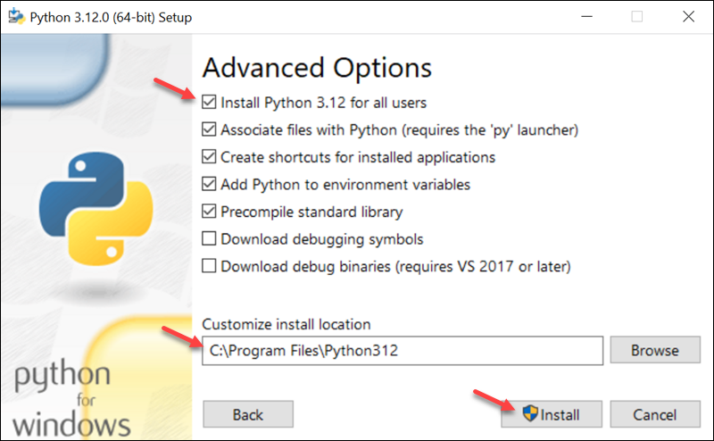

Slide 7
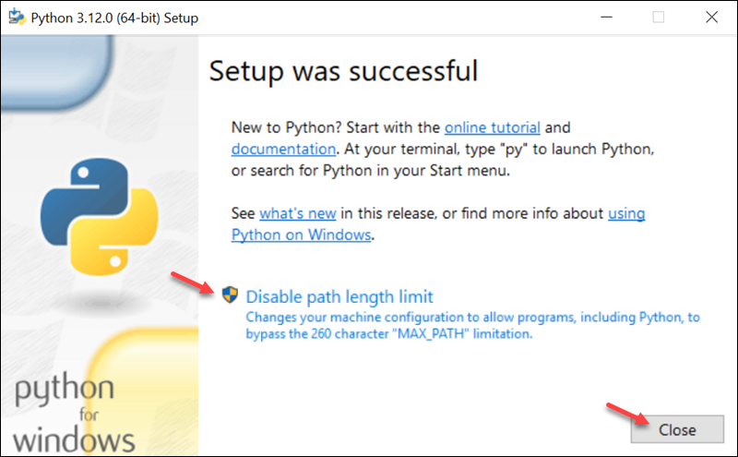

Slide 8
Installing necessary packages
Press “WIN+R” => type “cmd” and press “enter”.
Enter the following command to install packages.
pip install <package_name>
Required packages
pandas, bs4, requests, jupyterlab, selenium, webdriver-manager

Slide 9
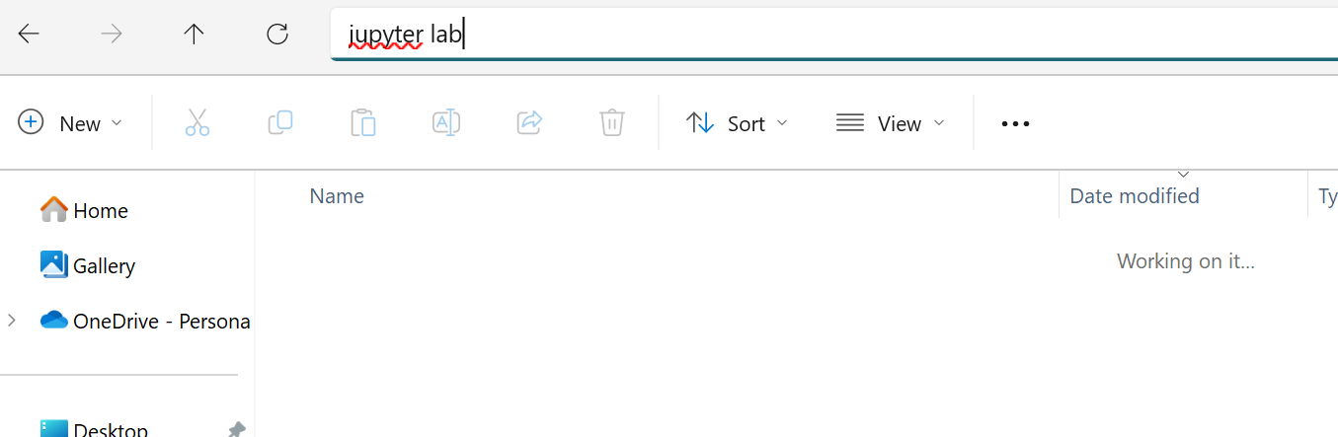
Let’s check Python installation
Create a new folder and rename it.
Open the folder.
Enter “jupyter lab” in the address bar.

Slide 10
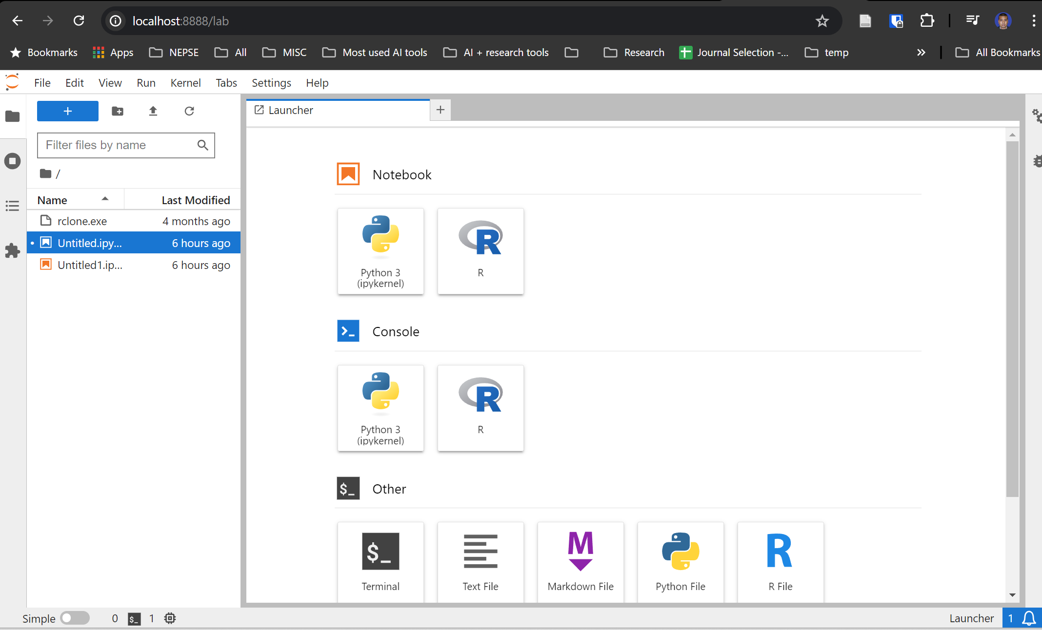

Slide 11
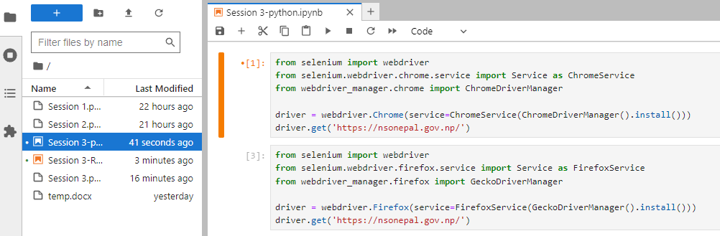
We can use either Chrome or Firefox browser for web scraping.
We will use Firefox and keep the code of the 2nd cell

Slide 12
Setting up R

Slide 13
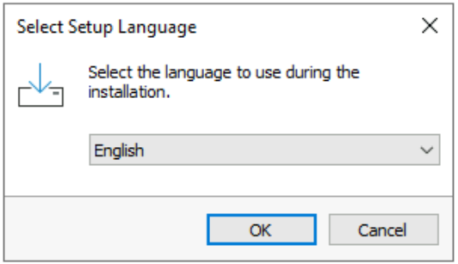

Slide 14
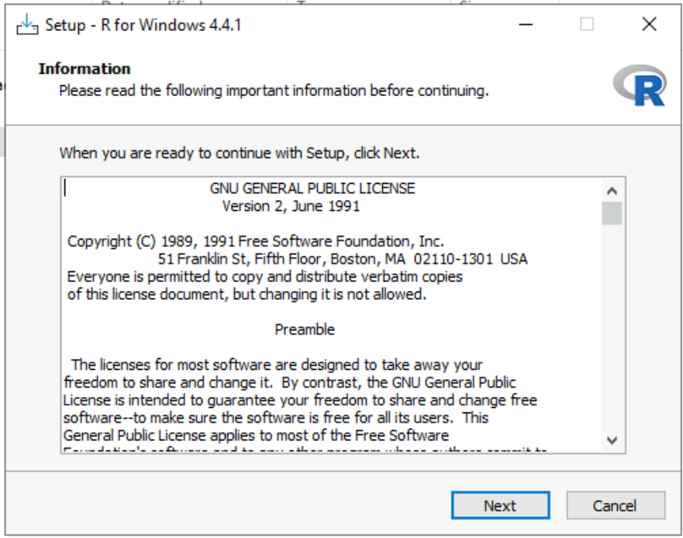

Slide 15
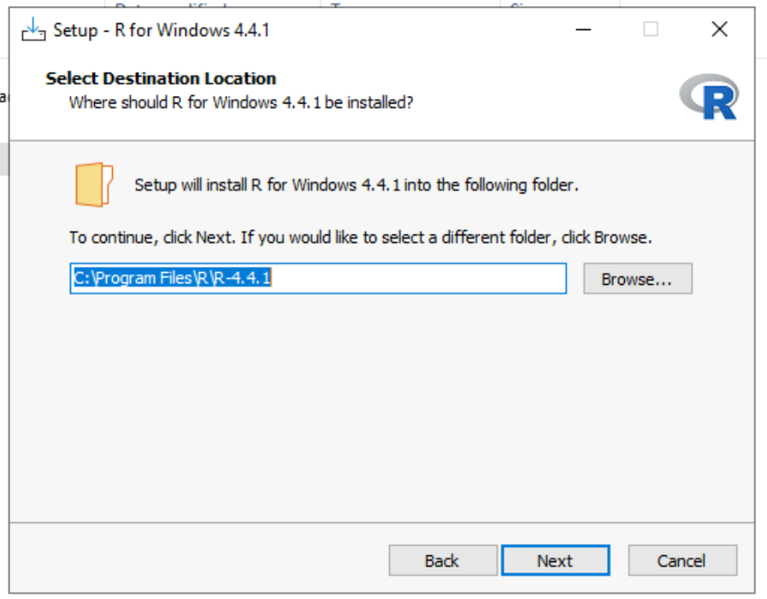

Slide 16
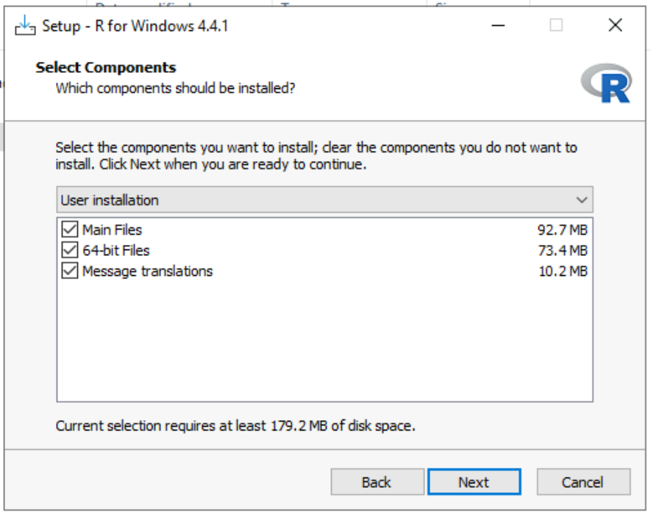

Slide 17
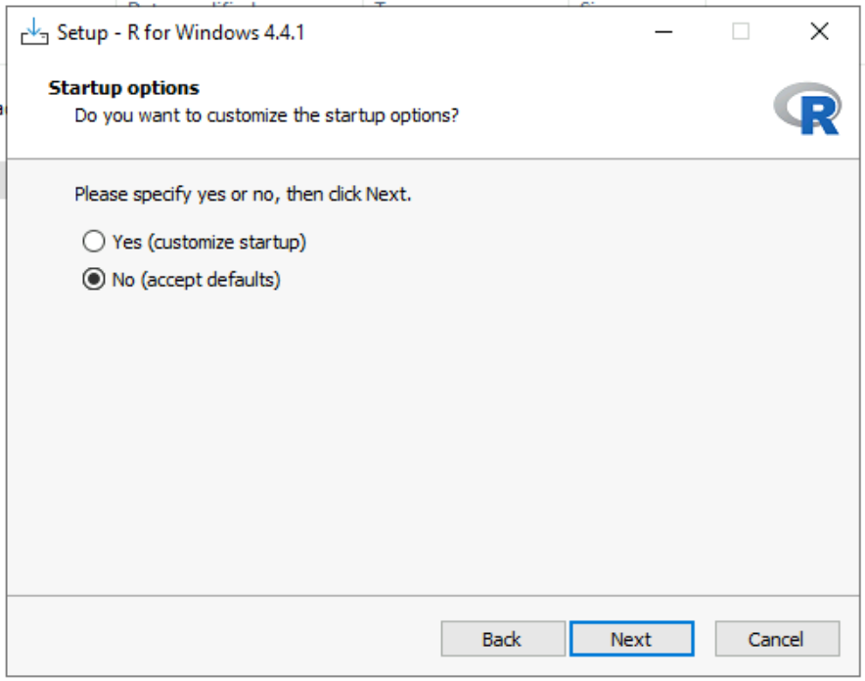

Slide 18
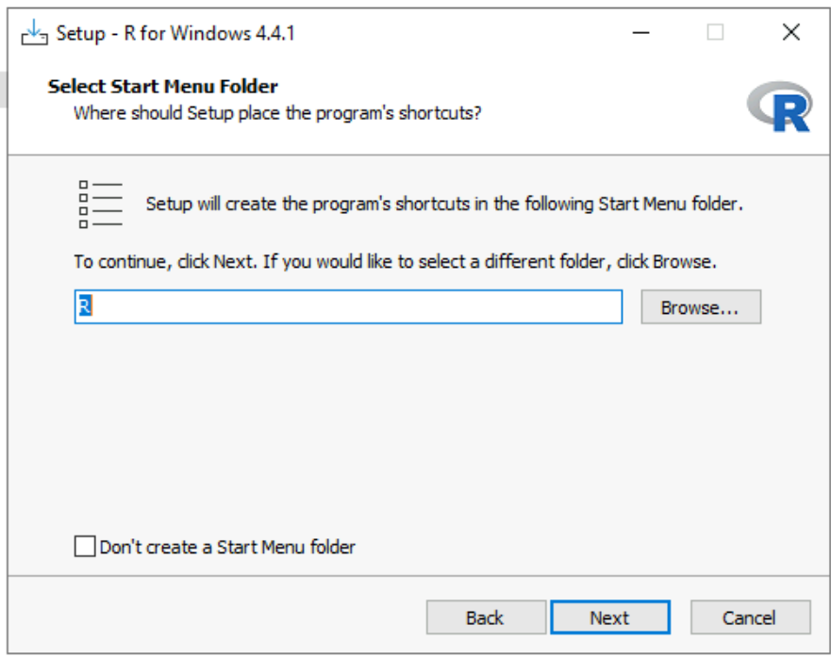

Slide 19
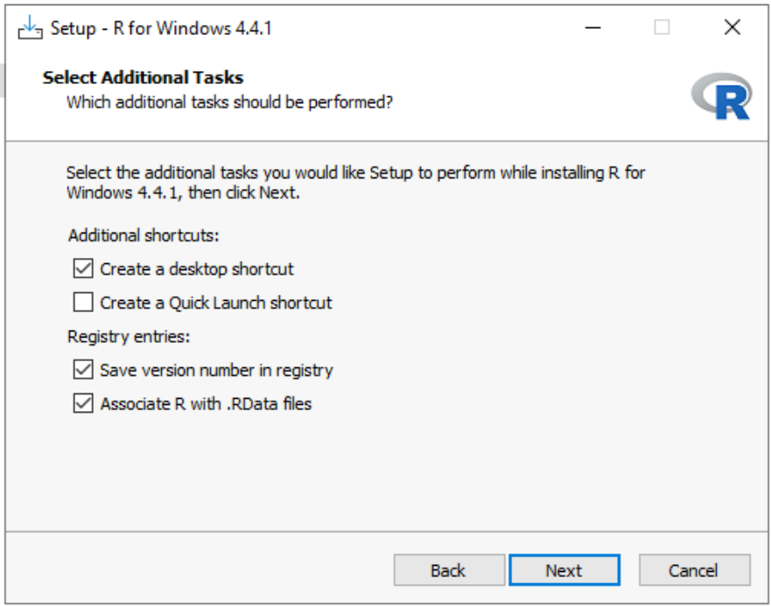

Slide 20
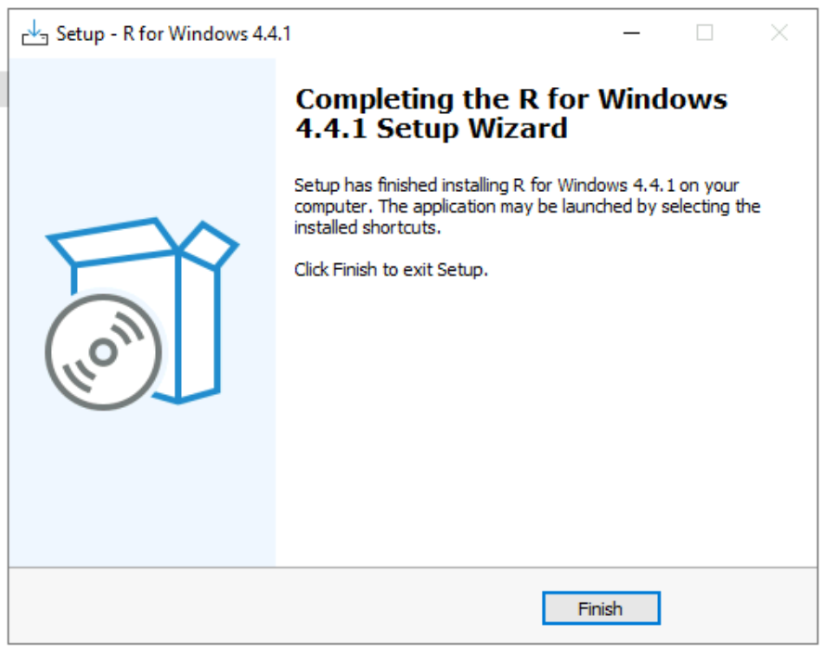

Slide 21
Setting up R for Jupyter Lab
Press “WIN” key and search Rgui app and execute.
Install “IRkernel” package and configure for jupyterlab.
Now, open jupyter lab following the same process as we have done in python setup.

Slide 23
Setting up RSelenium
Install java using jre-8u411-windows-i586.exe file.
Install firefox using Firefox Setup 127.0.exe file.
Install the following packages:
install.packages(c('RSelenium','rvest','netstat','httr','dplyr'))
Run the following code in the jupyter notebook.
library(RSelenium)
library(netstat)
library(httr)
rD <- rsDriver(browser = "firefox", port = free_port())
remDr <- rD$client
remDr$navigate("https://www.google.com")

Slide 24
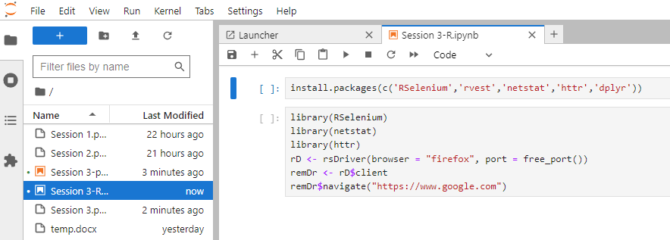

Slide 25
Setting up RSelenium
An error will occur due to a bug in recent RSelenium version. To solve this bug, go to C:\Users\<username>\AppData\Local\binman\binman_chromedriver\ , search for all LICENSE.chromedriver file and delete it.
Re-run the code in the jupyter notebook again.

Slide 26
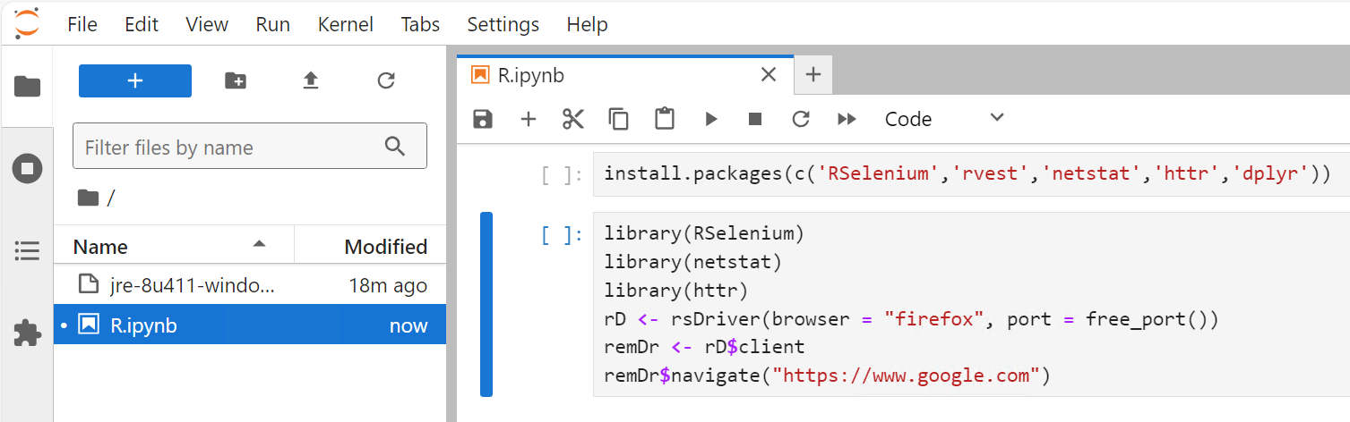

Slide 27
Thank you

